Slide 1
SALES EDA CASE STUDY
KHADIJA SULTANA
MALIHA WASEEM

Slide 2
PROBLEM STATEMENT
PROBLEM STATEMENT :
An ABC company has the sales data for the last 3 years and they want to analyze it now. There is a Dimension Data where there is the list of companies and their Line of Business. There are 3 years of sales data. There is also a Target Data. Stakeholders want the following insights
Include important KPIs
Sales over Time
Sales for various Products
Manager wise analysis
Customer coverage across various Locations
Target Analysis

Slide 3
SALES OVERVIEW
The project entails analyzing three years of comprehensive sales data, encompassing invoice details, transaction amounts, dates, salespersons, and product specifics. Accompanying this dataset is Dimension Data, which furnishes a catalog of companies alongside their Line of Business (LOB), enabling segmentation and analysis based on customer industry or business category. Additionally, the Target Data, presumed to comprise predefined sales performance metrics, facilitates the crucial task of comparing actual sales against set targets, streamlining performance assessment and goal alignment efforts. This EDA aims to deliver actionable insights for optimizing sales strategies, enhancing customer engagement, and achieving organizational objectives.

Slide 4
DATA CLEANING

Slide 5
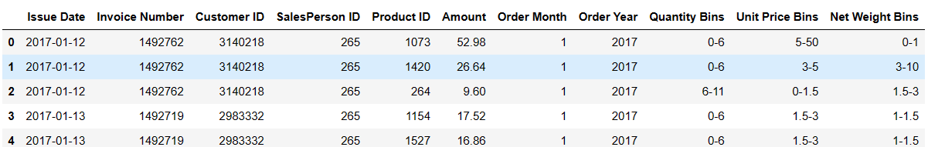
SALES DATASET
In the process of preparing the sales data for exploratory data analysis (EDA), three years of sales data have been concatenated into a single table. This unified dataset contains detailed information such as the issue date, customer ID, salesperson ID, product ID and various categorical bins derived from Qty Items, Unit Price, and Net Weight. A new column 'Amount' was added by multiplying 'Qty Items' into 'Unit Price'. Merging data from multiple years to gain a holistic view of sales trends, customer purchasing behavior, and product performance over time. This consolidated dataset enables comprehensive EDA, facilitating the identification of patterns, and outliers critical for strategic decision-making in sales, marketing, and inventory management. Additionally, by categorizing relevant variables into bins, the dataset becomes more interpretable and actionable, allowing for deeper insights into the distribution and segmentation of sales data.

Slide 6
DIMENSION TABLES
The dimension tables contain crucial information about customers, products, product groups, and salespersons, providing a comprehensive overview of various aspects essential for analytical purposes.
The customers table contains unique customers with key attributes like Customer ID, Company Name, Status, and geographic information. It serves as a rich source for customer-centric analysis and segmentation, facilitating targeted marketing strategies and customer relationship management. In contrast, the products table provides insights into individual products through identifiers such as Product ID and Group ID, enabling analysis of sales performance and inventory management. The product_grp table consolidates 36 distinct product groups with categorical information, aiding in understanding product hierarchies and informing strategic decisions on product assortment and marketing. Lastly, the salesperson table offers insights into sales team structures, supervision chains, and managerial hierarchies, enabling effective management and performance evaluation of sales teams. Together, these dimension tables form a comprehensive foundation for analyzing various facets of business operations, supporting decision-making processes across different functional areas within the organization.

Slide 7
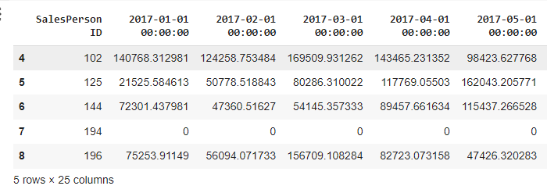
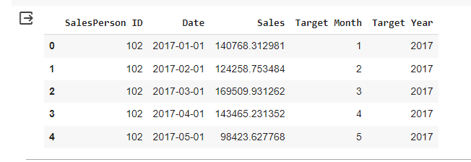
TARGET DATA SET
In preparing the target data for analysis, a series of steps were implemented to transform an initially imbalanced dataset into a more normalized and analytically suitable format. First, missing values were addressed by employing the dropna() function, effectively eliminating any rows lacking essential information. Subsequently, the column headers, initially located in the second row, were adjusted for consistency and proper indexing by removing the first row and assigning the second row as the new headers using the columns attribute. Timestamps embedded within the column headers were then converted to the MMYYYY format through the map() function, enhancing their interpretability for analysis. The dataset underwent a pivotal reshaping process using the melt() function, transitioning from a wide to a long format, thereby consolidating monthly sales figures under a single 'Sales' column alongside corresponding 'SalesPerson ID' and 'Date' columns, facilitating more streamlined analysis. To ensure data consistency and facilitate analysis, data types were uniformly adjusted, with the 'Sales' column converted to numeric, and 'Target Month' and 'Target Year' columns categorized, while the 'SalesPerson ID' column was standardized to a string data type. Sorting the dataset chronologically and resetting the index validated the transformation process, while summary statistics such as mean, median, minimum, and maximum provided an overarching perspective, ensuring the dataset's analytical suitability. Through these systematic steps, the dataset was successfully transformed into a normalized format, primed for comprehensive analysis of sales performance over time.
BEFORE : AFTER :

Slide 8
UNIVARIATE ANALYSIS

Slide 9
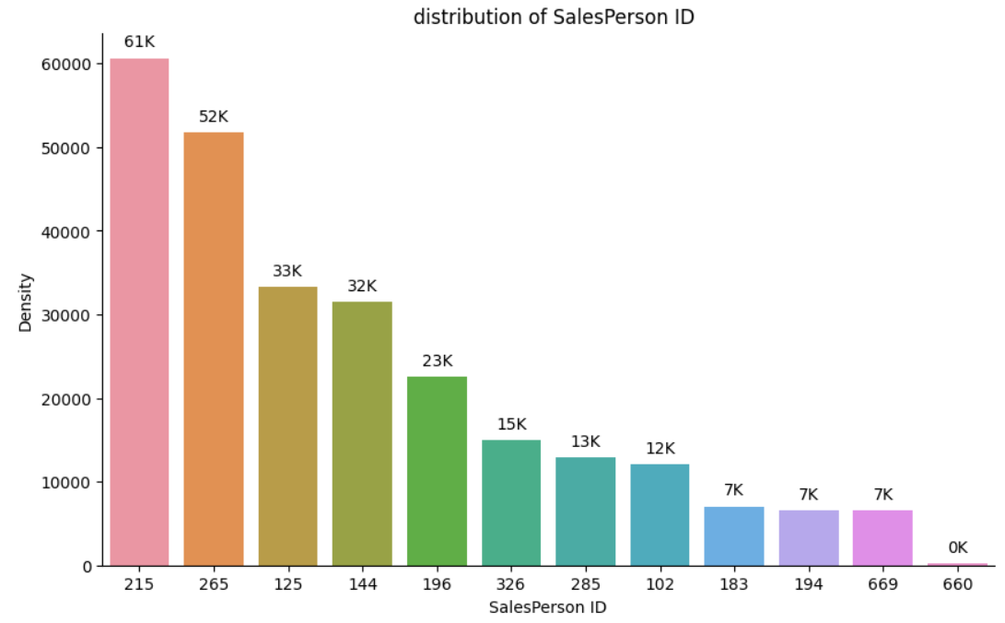
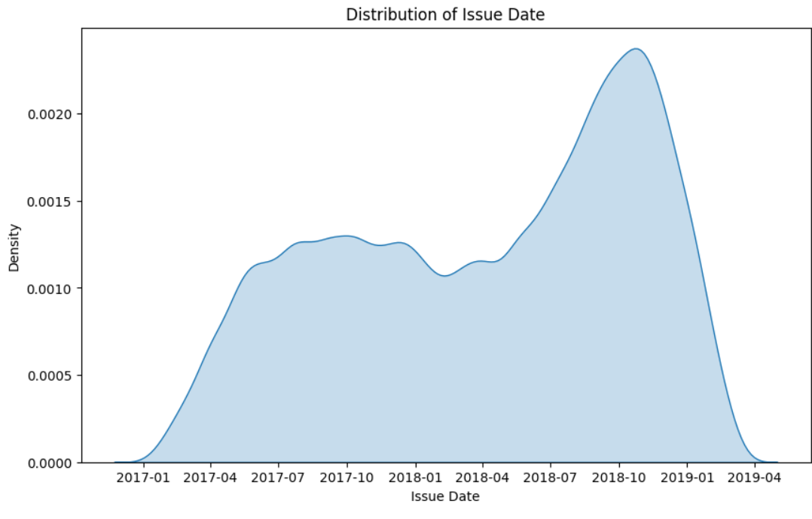
ISSUE DATE
The distribution of issue dates in the dataset reveals insights into the frequency and range of transactions over time. KDE plot illustrates that issue dates are comparatively more concentrated within a specific timeframe, with a notable peak observed between October 2018 and January 2019. This concentration suggests that a significant portion of sales transactions occurred during this period, indicating potential trends or patterns in customer behavior, market demand, or business activities.
SALESPERSON ID
The visualization reveals variations in the distribution of SalesPerson IDs, indicating differences in individual sales performance or responsibilities. Some SalesPerson IDs exhibit higher frequencies, suggesting greater involvement or productivity such as Id-215,265, while others have lower counts, potentially indicating different roles within the sales team or varying levels of activity(669,660).

Slide 10
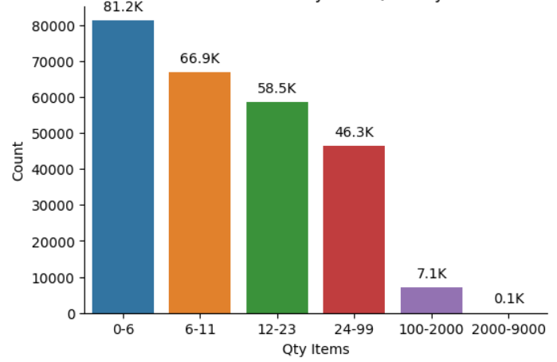
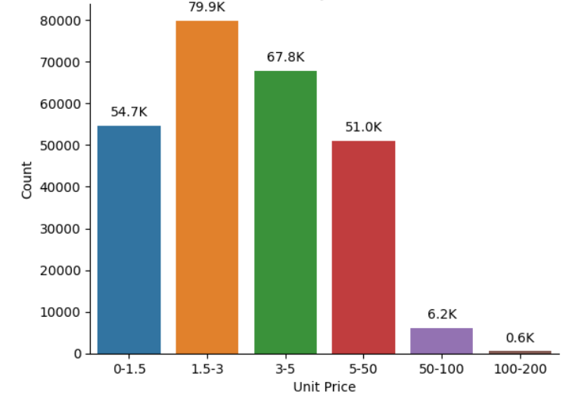
QTY ITEMS
The bins ranging from 0 – 6 bin items have the highest counts, indicating that a significant portion of transactions involves a relatively small quantity of items per purchase. This suggests that most customers tend to purchase smaller quantities of items at a time.On the other hand, bins representing quantities ranging from 100 - 9000 bin items have the lowest counts. This indicates that transactions involving very large quantities of items are less frequent, likely representing bulk or wholesale purchases.
UNIT PRICE
The countplot visualizes the distribution of unit prices by dividing them into predefined bins. Each bin represents a range of unit prices, and the height of the bars indicates the frequency of unit prices falling within each range.The analysis reveals that unit price bins between 1.5 and 5 have the highest counts, suggesting that a significant portion of transactions involves products within this price range. On the other hand, unit price bins ranging from 50 to 2000 have the lowest counts, indicating that transactions involving higher-priced products are less frequent.

Slide 11
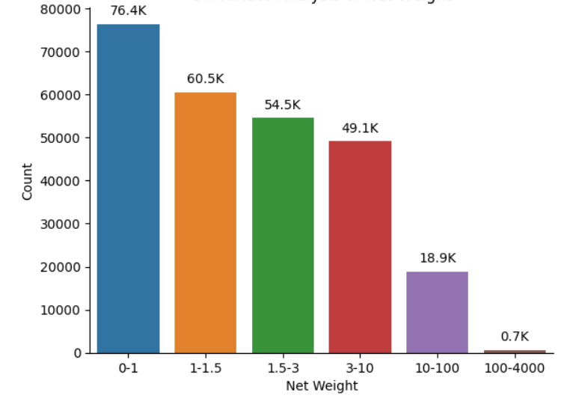
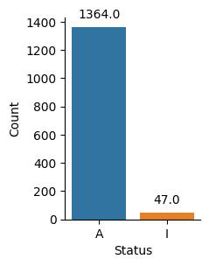
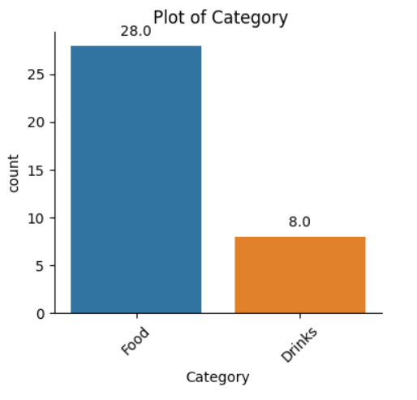
NET WEIGHT
net weight bins ranging from 0 to 1.5 have the highest counts, suggesting that a significant portion of transactions involves products with lower net weights. On the other hand, net weight bins ranging from 100 to 4000 have the lowest counts, indicating that transactions involving products with higher net weights are less frequent.
CATEGORY
The distribution plot of product groups by category provides insights into the composition of the product. The majority, approximately 77.77%, of the products belong to the food category, indicating that food products constitute a significant portion. Conversely, approximately 22.22% of the products belong to the drinks category, representing a smaller proportion compared to food products. This distribution highlights the dominance of food-related items, suggesting that the business may primarily focus on or specialize in food products.
STATUS
customer status reveals that the majority, or approximately 96.6%, of customers belong to status A. This suggests a high level of engagement or activity among this segment of customers, likely representing regular or active patrons of the business. On the other hand, a small proportion, around 3.3%, belong to status I. This minority group may consist of inactive or infrequent customers, possibly indicating a need for targeted efforts to re-engage or incentivize their participation

Slide 12
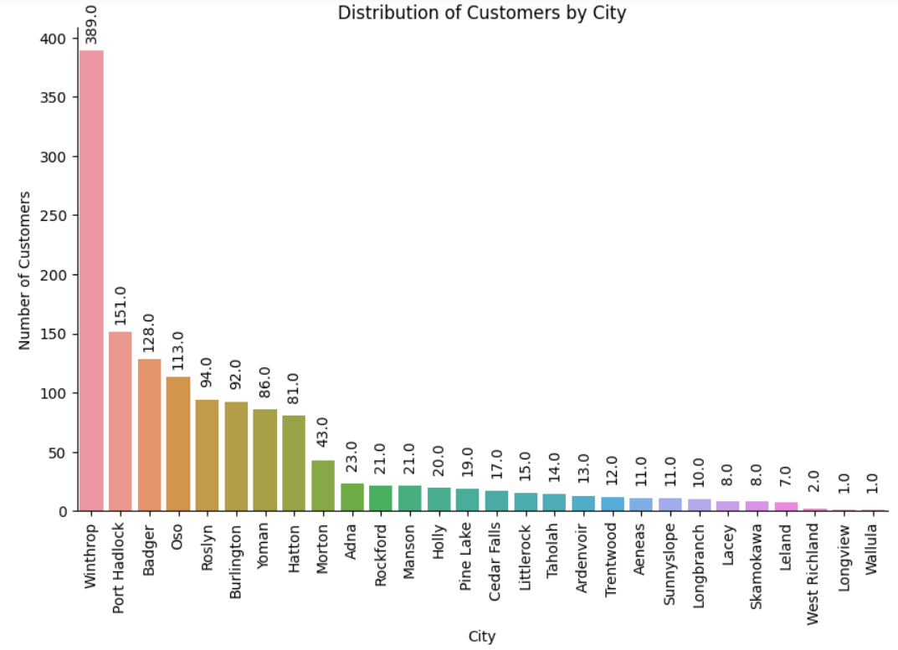
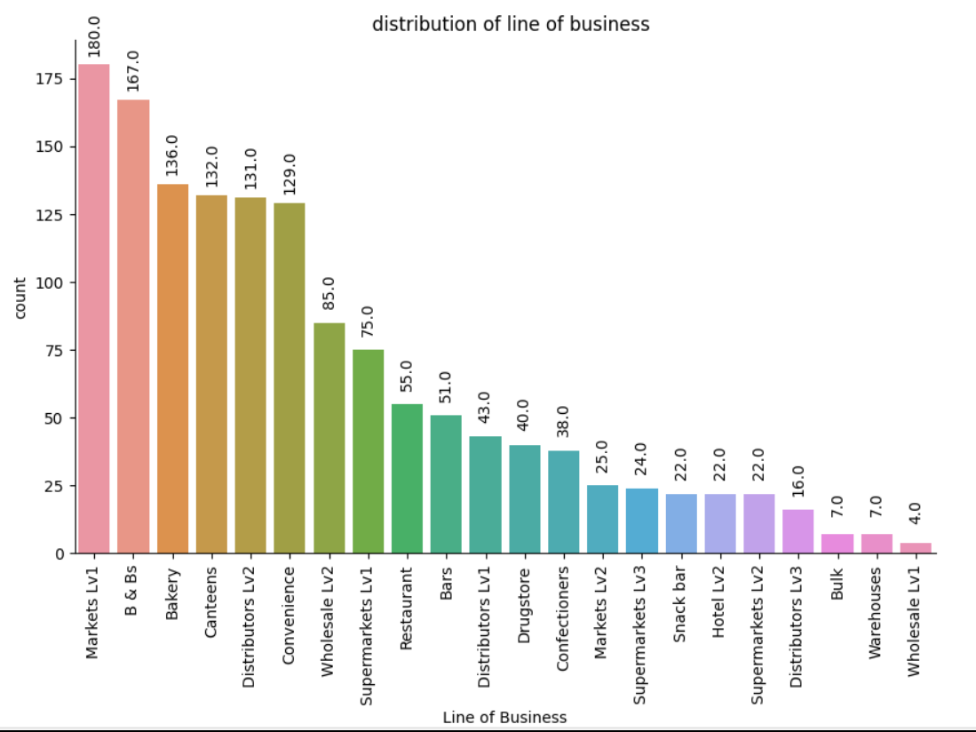
CITY The analysis of customers by city reveals varying levels of customer engagement across different locations. Winthrop emerges as the city with the highest number of customers, suggesting a significant presence or popularity among the customer base. Conversely, cities like Longview and Wallula have the lowest number of customers, indicating relatively lower levels of engagement or representation in these areas.
LINE OF BUSINESS The distribution of Line of Business reveals varying levels of engagement across different sectors within the customer base. Markets Lv1, B&Bs, bakeries, and canteens exhibit higher counts, indicating significant representation and activity within these segments. This suggests that a considerable portion of the customer base is comprised of businesses operating in these sectors, potentially highlighting areas of focus for targeted marketing and tailored services. Conversely, the counts for warehouse bulk and wholesale businesses are comparatively lower, implying a smaller presence or lesser engagement within these segments.

Slide 13
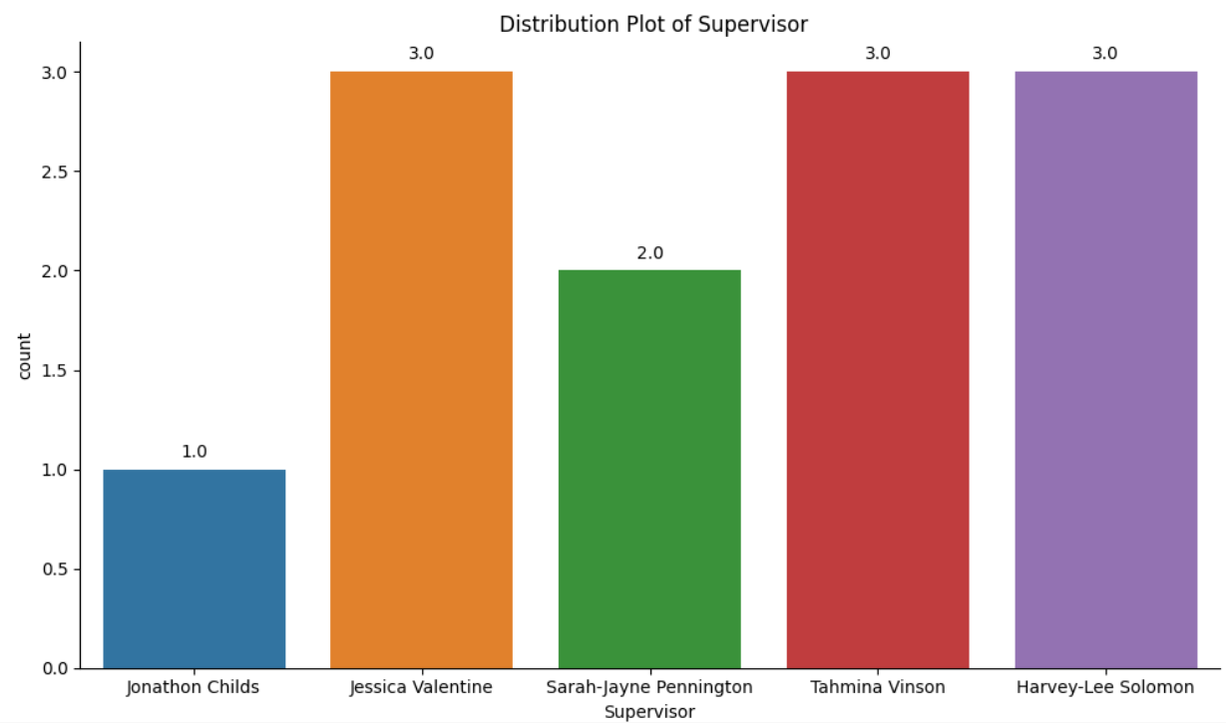
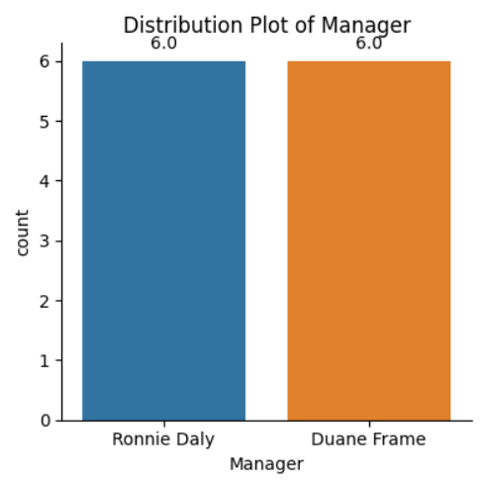
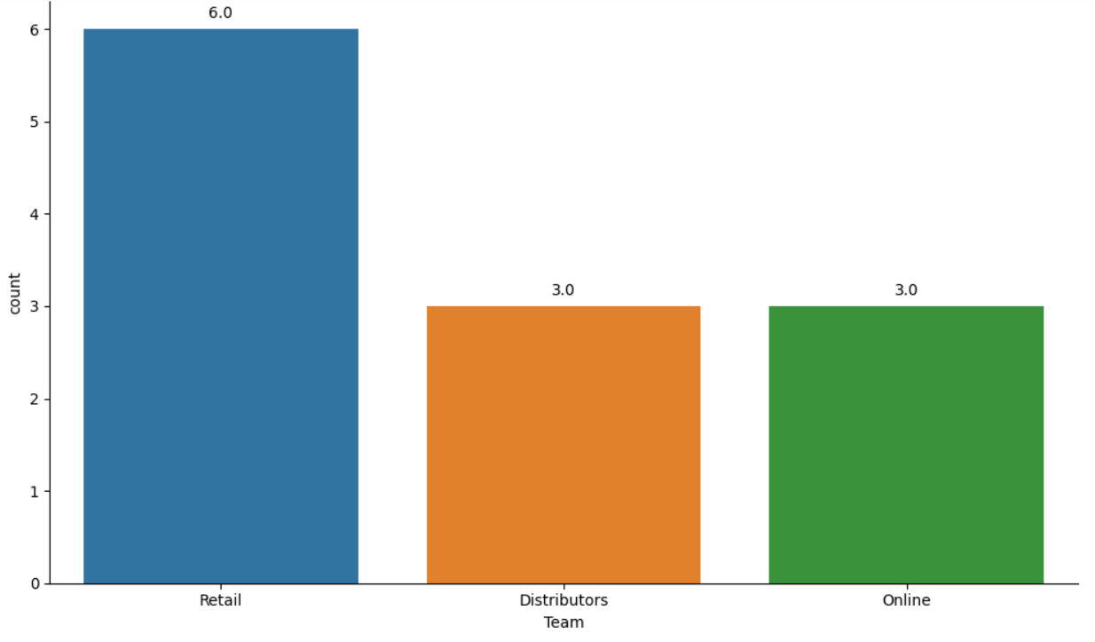
VARIABLE SUPERVISOR
Jessica, Tahmina, and Harvey-Lee have a higher count of supervised salespersons compared to Jonathan. Conversely, Jonathan supervises a lower number of salespersons. This discrepancy in the distribution suggests variations in workload or organizational hierarchy among supervisors. Jessica, Tahmina, and Harvey-Lee may oversee larger teams or have broader responsibilities within the sales organization, while Jonathan's team may be relatively smaller or focused on specific tasks.
VARIABLE MANAGER
salespersons are almost equally distributed among the managers, Ronnie Daly and Duane Frame. This indicates a balanced workload distribution or a similar number of salespersons reporting to each manager.
VARIABLE TEAM
The plotted distribution shows the count of salespersons in each team. The "Retail" team has the highest count, followed by "Online" and "Distributors". In contrast, the "Online" and "Distributors" teams have lower counts compared to "Retail." This suggests that the organization may focus more on retail sales channels or have a larger sales force dedicated to retail operations.

Slide 14
BIVARIATE ANALYSIS

Slide 15
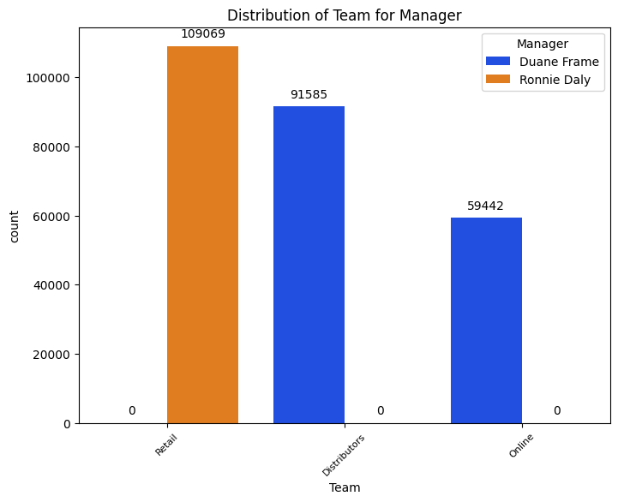
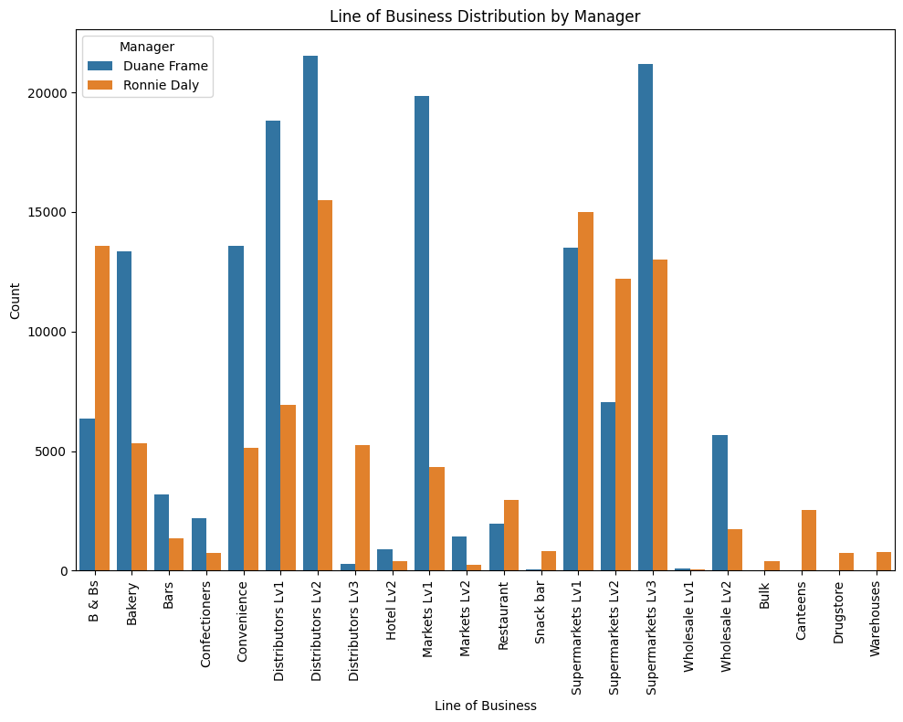
Manager
The managerial structures and team compositions of Duane Frame and Ronnie Daly offer insights into their respective operational focuses and organizational dynamics. Duane Frame's managerial domain encompasses a diverse team comprising both retail and online sales channels, suggesting a broad market approach. The sales team under Duane Frame's purview includes a mix of seasoned professionals such as Shakil, Akeel, Dominykas, Tahmina, Lorenze, Kien, and McGee, implying a balanced blend of experience and expertise across various sales functions.
In contrast, Ronnie Daly's managerial scope centers primarily on the retail sector, potentially indicating a more targeted approach or specialization within a specific market segment. Ronnie Daly's sales team comprises individuals like Sahil, Seymour, Gillian, Serenity, Hywell, and Ayaana, suggesting a focused yet diverse sales force catering to retail-specific demands.
Supervisory oversight within Duane Frame's team is provided by Tahmeena and Harvey-Lee, further bolstering the managerial structure with experienced guidance and support. Ronnie Daly's managerial supervision is facilitated by Sarah, Jessica, and Jonathon, potentially offering specialized leadership tailored to the retail-focused operational environment.
A comparative analysis of the managerial statuses reveals nuanced differences in their organizational compositions. Duane Frame's managerial roster reflects a higher proportion of individuals within status A (55%), suggesting a stable and established managerial framework with a predominant focus on operational effectiveness. In contrast, Ronnie Daly's managerial team exhibits a slightly lower percentage within status A (40%), indicating a potentially evolving or dynamic managerial landscape.
Furthermore, a breakdown of managerial categories highlights distinctive operational emphases. Duane Frame's managerial domain predominantly encompasses food-related sectors (56%), with a minor representation in the drinks category (1.9%). This underscores a strategic alignment with sectors like distributors, bakery, and supermarkets, while excluding areas such as bulk, warehouses, and drugstores.
Conversely, Ronnie Daly's managerial portfolio demonstrates a significant presence in sectors like B&Bs, distributors, and supermarkets, suggesting a targeted approach towards segments catering to diverse consumer needs and preferences. This strategic emphasis underscores a focus on operational agility and market responsiveness within Ronnie Daly's managerial purview.

Slide 16
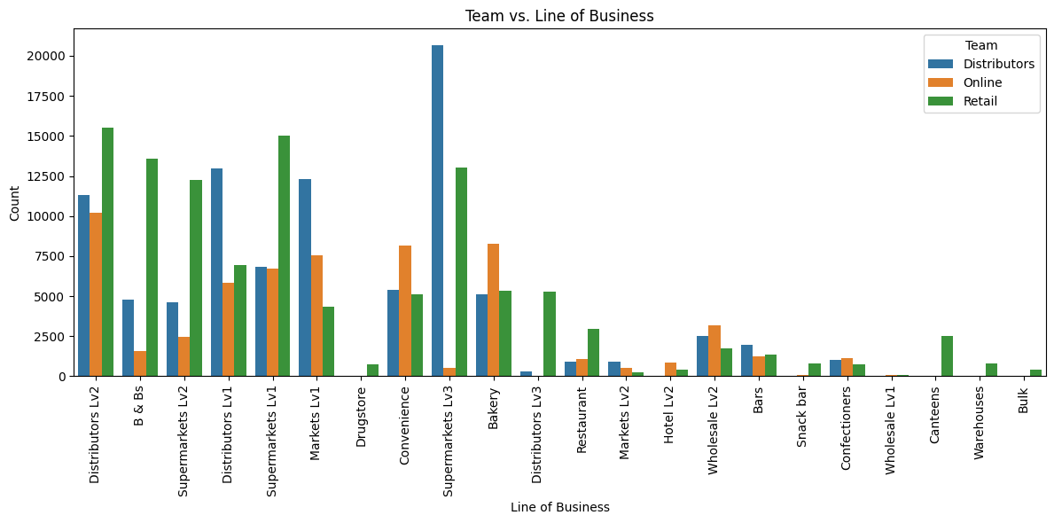
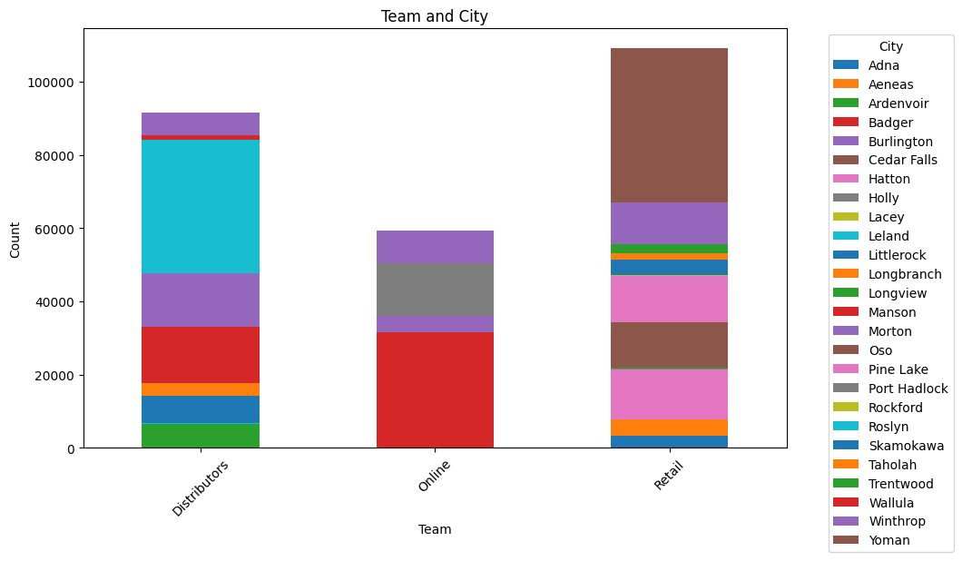
Team
Teams within the organization play pivotal roles in driving sales and operational effectiveness across various sectors. Distributors, constituting 35.21% of the teams, boast significant representation from key individuals like Akeel Mcleod, Shakeel Durham, and Kien Mcgee, underscoring their integral role in distribution channels. Meanwhile, the Online team, representing 22.85% of the workforce, is led by prominent figures such as Dominykas Bird, Lorenzo Donovan, and Tatiana Adamson, showcasing their prowess in digital sales channels. Retailors, comprising 41.93% of the teams, demonstrate diverse leadership from individuals like Ayaana Mackeenzie, Gillian Gonzales, Sahil Seymour, and Serenity Rich, highlighting their impact in traditional retail avenues.
In terms of managerial statuses, Distributors exhibit a notable percentage within status A (33.71%), reflecting a focus on operational excellence and efficiency, while Online teams follow closely behind with 22.17% within status A. Retail teams lead with the highest percentage within status A (40.85%), indicating a commitment to excellence in retail operations. Moreover, cities predominantly associated with Distributors (35.21%), Online (22.85%), and Retail (41.93%) underscore the geographic distribution of sales teams and operational centers.
Analysis of product sales reveals Retailers and Distributors as key contributors, particularly in the food and drinks categories, with 37% and 38% of drink sales, and 33% and 38% of food sales, respectively. Notably, oils and wheat flours emerge as top-selling items, while teas and tomato sauces rank among the least popular products, indicating shifting consumer preferences and market dynamics

Slide 17
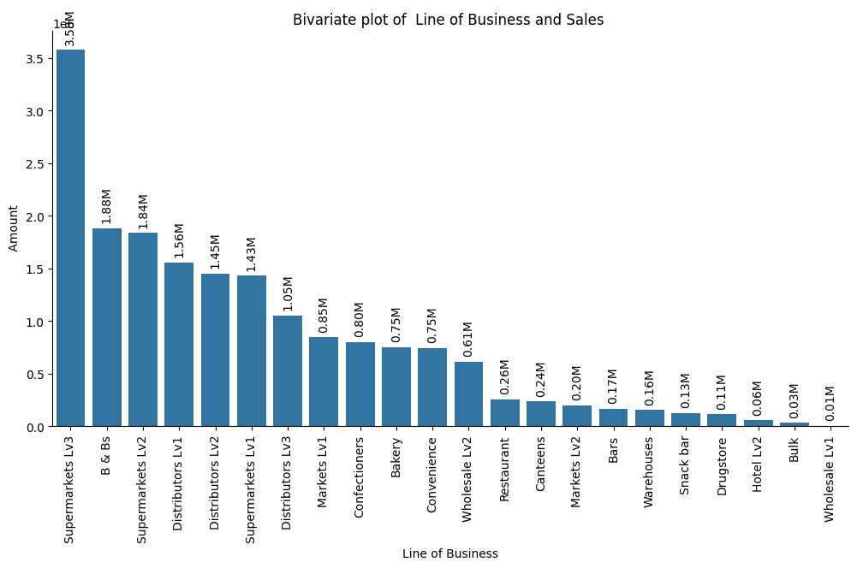
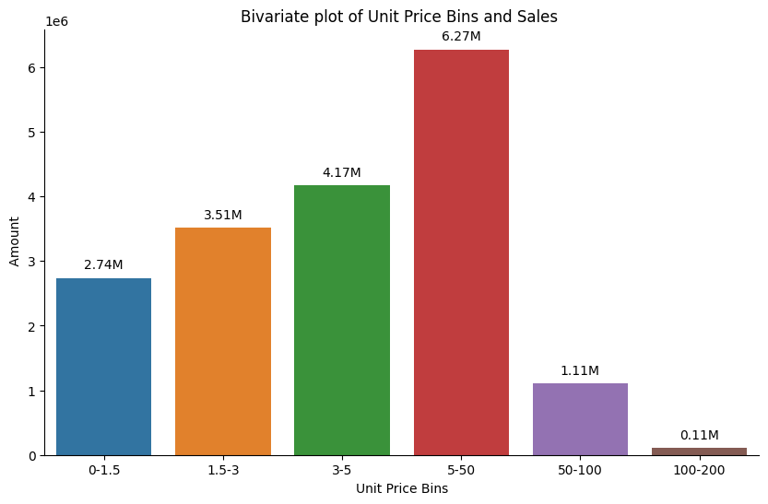
Amount(total sales)
The sales analysis unveils intriguing insights into product performance across various metrics. Quantity bins ranging from 24-99 and 100-2000 emerge as the most lucrative, indicating robust demand within these ranges. Similarly, unit price bins of 5-50 exhibit strong sales, while those in the range of 100-200 lag behind.
Net weight bins further highlight sales trends, with categories like 0-1 and 1-1.5 showing significant traction. Salesperson 215 leads in sales, while 326 trails as the lowest performer. Supervisors Sarah Jain and Tahmina stand out for their high sales figures, contrasting with Jessica, who records the lowest.
Managerial analysis reflects Duane Frame's dominance with $8.60 million in sales, closely followed by Ronnie Daly at $7.42 million. The retail team emerges as the top performer, contributing $7.42 million in sales, while distributors follow with $4.81 million, and online platforms record the lowest at $2.79 million.
Key players in the market, including Dragonwalk, Red Beat, and Prophecy Lighting, lead in sales, while others like Tortoisecurity and Berry Master lag behind. Notably, the highest sales originate from Supermarket Lv3, totaling $3.5 million, with Wholesale Lv2 and Bulk registering the lowest figures.
Geographically, Yoman ranks first with $3.3 million in sales, while Lacey ranks at the bottom. Product-wise, staples like wheat flours ($4.47 million), yeast ($2.20 million), and oils ($2.19 million) dominate the sales charts, whereas less popular items like teas, tomato sauce, and sprinkles struggle to gain traction.
In terms of categories, food products lead significantly, contributing approximately $16.37 million in sales, while drinks lag behind at $1.54 million. This comprehensive overview provides valuable insights into sales dynamics, product preferences, and market trends, guiding strategic decision-making for businesses.

Slide 18
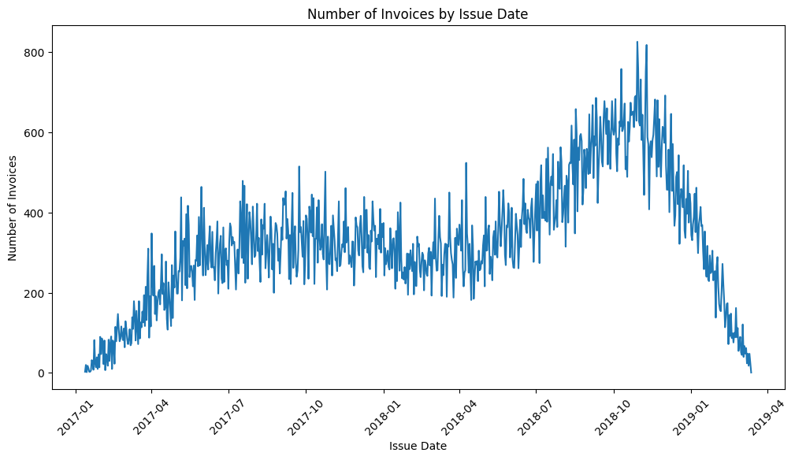
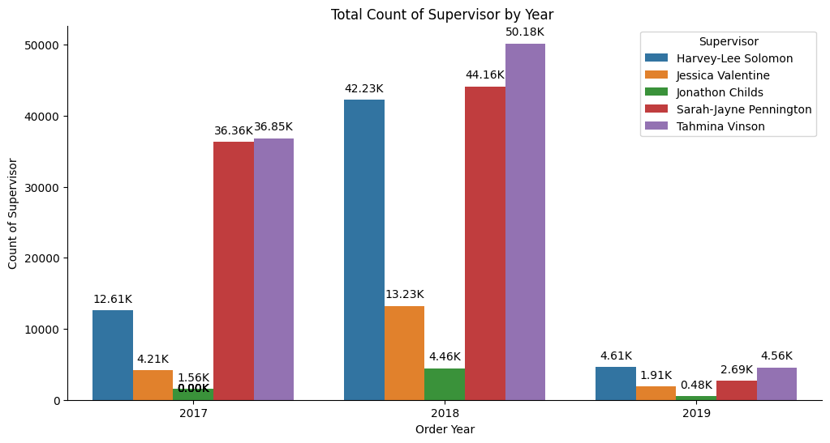
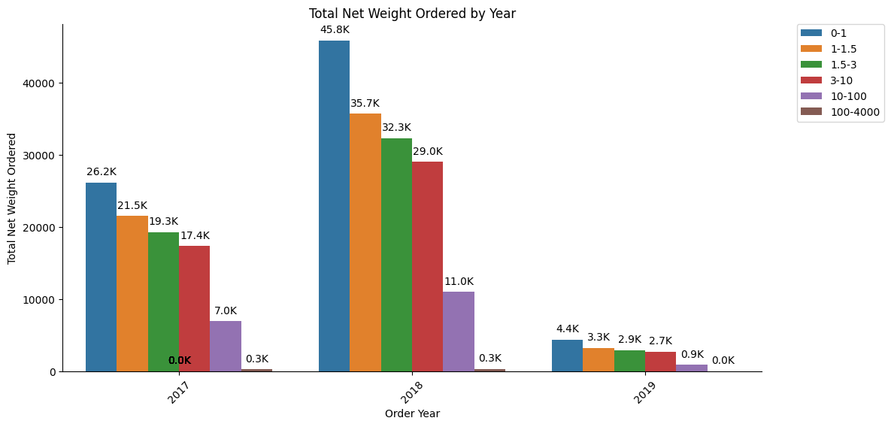
Issue Date
The analysis of order trends reveals intriguing patterns over the years. From October 2018 to January 2019, there's a notable surge in the number of invoices generated, indicating heightened activity during this period. This aligns with the observation that most orders were placed in the year 2018, suggesting a peak in transaction volume during that time frame. In terms of quantity bins, the 0-6 range emerges as the most common across the years, while the 2000-9000 range sees the least activity.
Examining net weight categories, the 0-1 and 1-1.5 bins consistently witness the highest number of orders, while the 100-4000 range consistently sees the least. Sahil and Shakil stand out as the top-performing salespersons each year, consistently generating more orders compared to their peers.
At the supervisory level, Tahmina and Harvey-Lee demonstrate a gradual increase in orders towards the end of 2018. Moreover, Tahmina and Sarah consistently lead in orders per month across the years, with Jonathon trailing behind. In terms of yearly performance, Tahmina and Sarah also excel, showing higher order counts in 2018 and 2017 compared to other supervisors

Slide 19
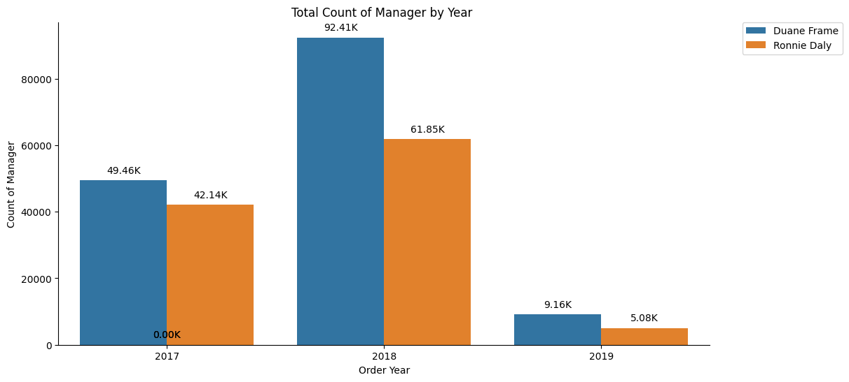
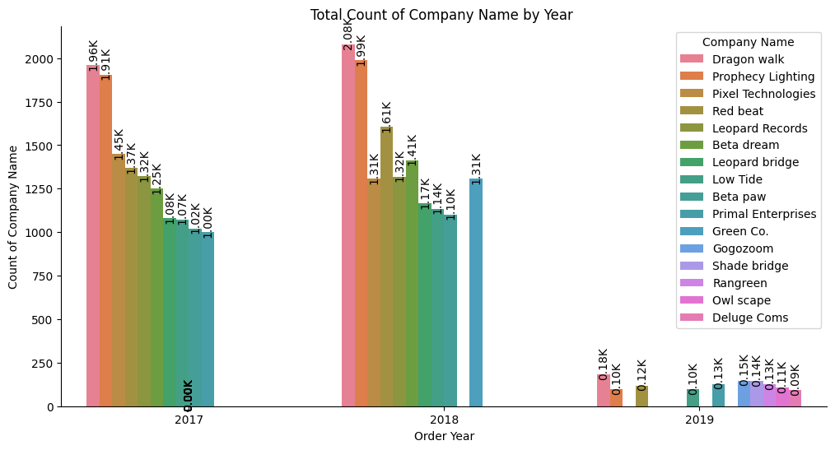
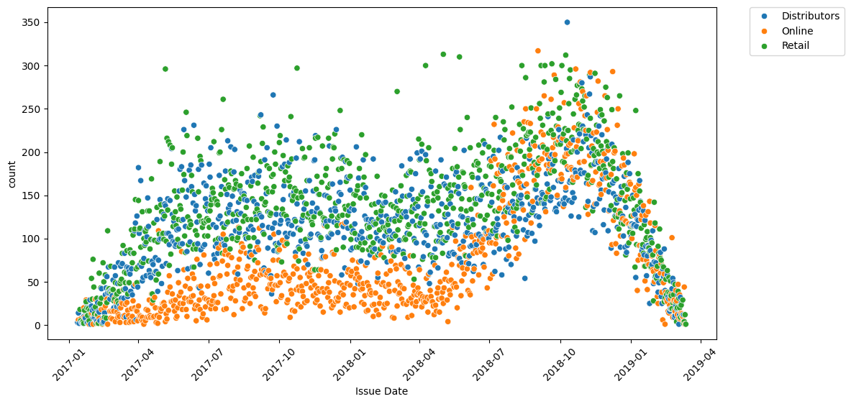
Order year,Order Month
Managerial analysis reveals that Duane Frame oversees more orders than Ronnie Daly, with Duane Frame nearly doubling the orders from 2017 to 2018. Meanwhile, Ronnie Daly shows a respectable 20% increase in orders over the same period.
Monthly order trends highlight that retailors and distributors consistently generate more orders, with retailors leading the pack each year. Conversely, online platforms show the least activity in terms of order generation across all three years.
Notable companies such as Dragon Walk, Red Beat, and Prophecy Lighting emerge as leaders in terms of order volumes, showcasing their significance in the marketplace. Geographically, cities like Yoman, Roslyn, and Badger emerge as top performers each year, indicating robust economic activity and demand for products within these regions.

Slide 20
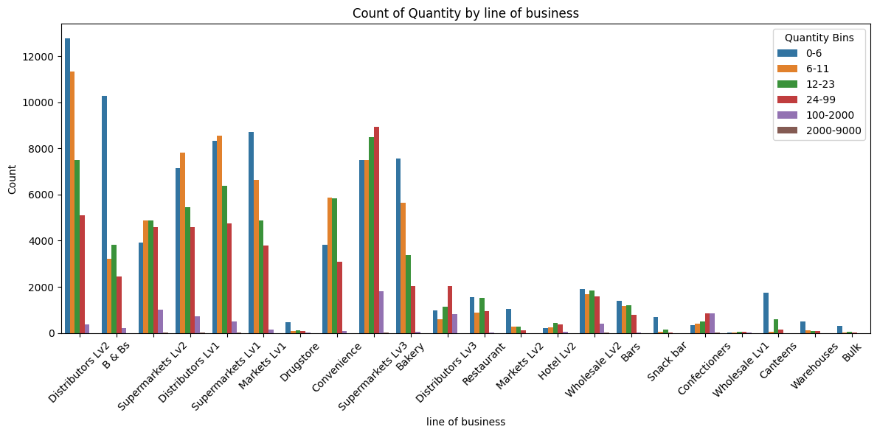
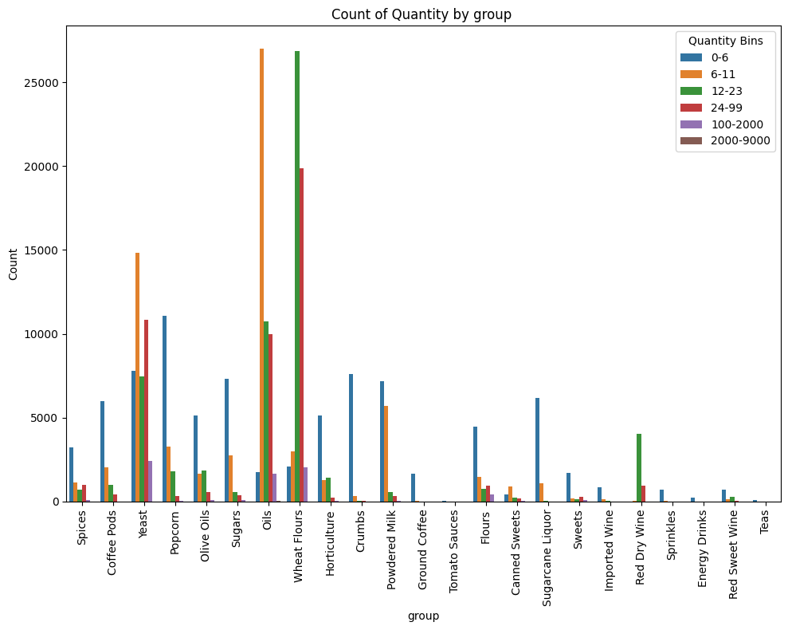
Quantity Items
The analysis reveals interesting insights into the distribution of quantity bins across different salespersons, product categories, and geographical locations. Shakil and Sahil stand out with a higher number of 0-11 quantity bins, indicating their involvement in transactions with smaller quantities. Conversely, Kien and Tess have the least count of quantity bins among all salespersons, suggesting a different focus or sales approach.
Among supervisors, Tahmina and Sarah have the highest count of all quantity bins, underscoring their active involvement in overseeing transactions across various quantity ranges. In contrast, Jonathon appears to have the least involvement in quantity bin-related activities.
When considering the types of businesses, supermarkets and distributors emerge with the highest count for 0-99 quantity bins, reflecting their involvement in a wide range of transactions covering different quantities. Conversely, confectioners show a preference for larger quantities, with more counts in the 100-2000 quantity bin range.
Geographically, locations like Roslyn, Badger, Winthrop, and Yoman exhibit the highest counts for quantity bins, indicating significant transactional activity across these regions. Conversely, locations such as Leland, Holly, and Lacey have lower counts, suggesting relatively lower transaction volumes.
Analyzing product categories reveals interesting patterns: oils and yeast predominantly fall within the 6-11 quantity bin range, indicating common transactional quantities for these items. Wheat flour and red dry wine are more prevalent in the 12-23 quantity bin range, suggesting larger transaction sizes. Meanwhile, coffee pods, popcorns, powdered milk, crumbs, and sugarcane liquor tend to belong to the 0-6 quantity bin range, highlighting their frequent sale in smaller quantities.

Slide 21
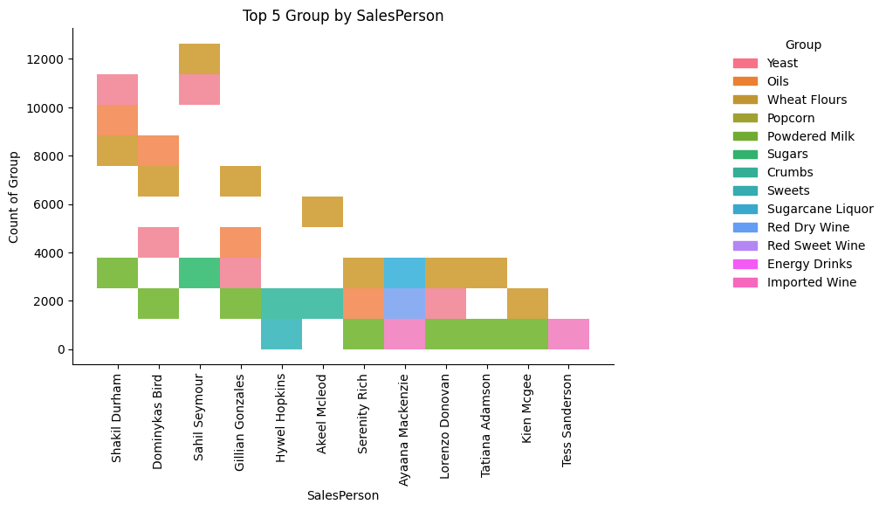
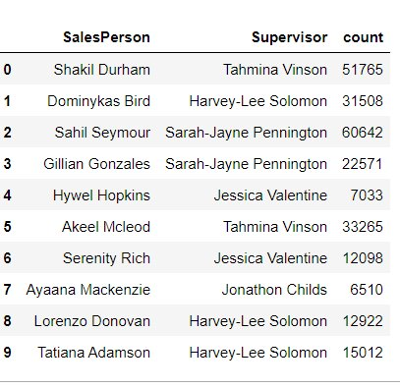
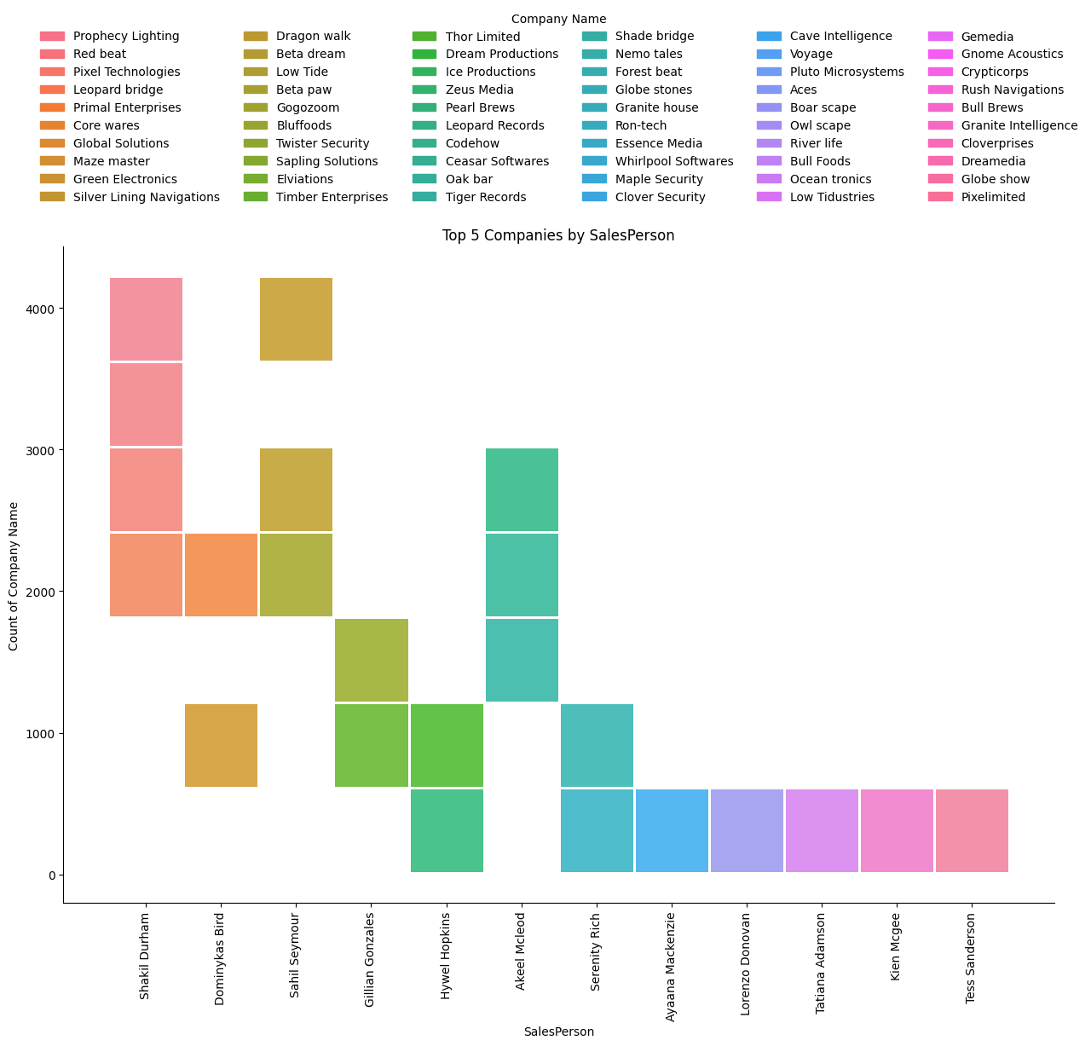
Salesperson
The overview of salespersons reveals distinct patterns and contributions within their respective territories and product lines. Shakil Durham and Dominykas emerge as key performers, demonstrating strong sales in products like yeast, wheat flours, popcorn, and powdered milk across areas like Roslyn, Manson City, and Badger. Conversely, Klen and Tess exhibit lower sales, particularly in imported wine, powdered milk, and flours. The top companies they engage with, such as Prophecy Lightning and Red Beat for Shakil, and Core Wares and Global Solutions for Dominykas, signify their significant client relationships and market presence. Despite variations in product focus and territory, all salespersons predominantly belong to Status A, underscoring consistent sales activity and customer engagement. Their involvement in diverse lines of business, spanning supermarkets, distributors, B&Bs, and bakery sectors, reflects adaptability and strategic alignment with market demands. Overall, this overview underscores the nuanced contributions and strategic orientations of each salesperson within the broader sales ecosystem.

Slide 22
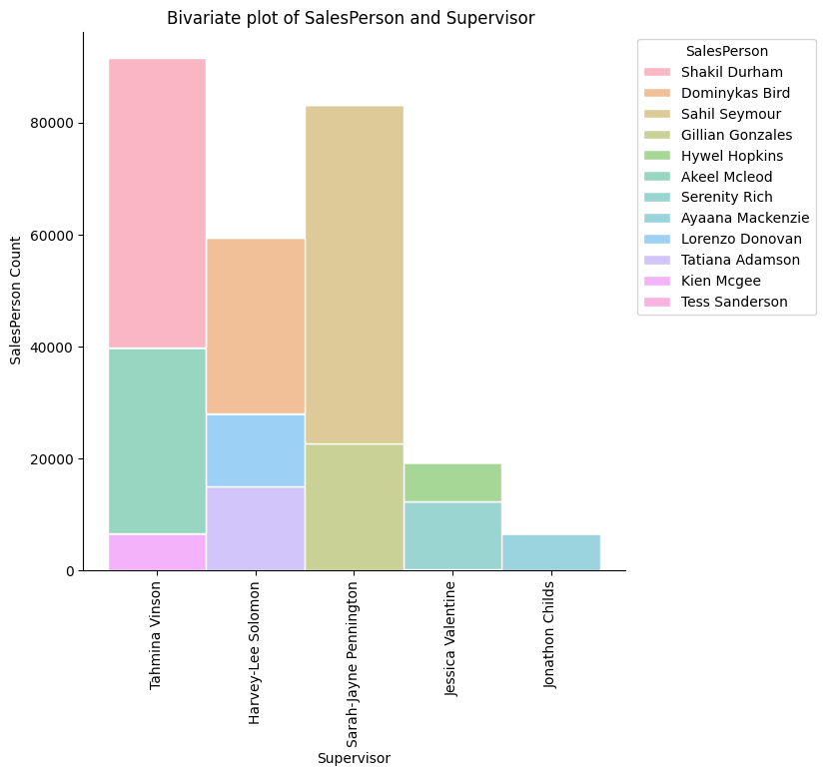
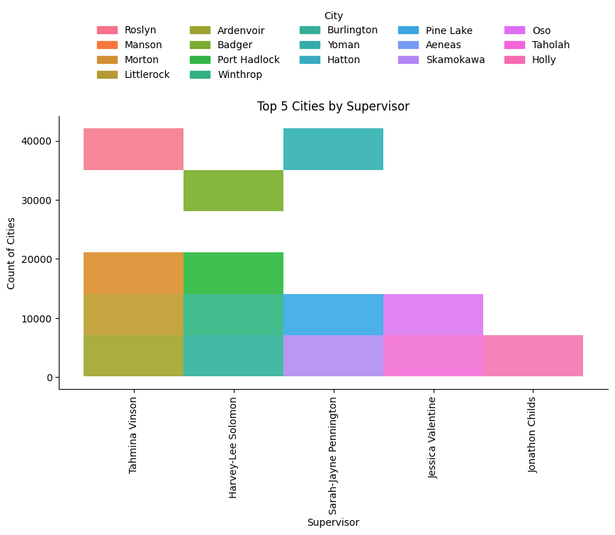
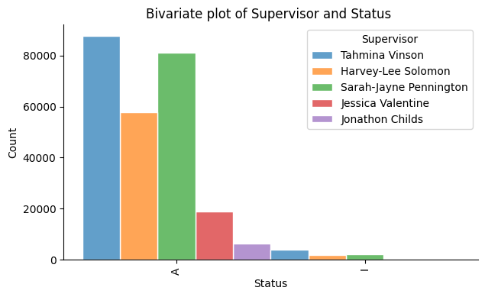
Supervisor
Top 5 Companies by Supervisor:
Tahmina Vinson oversees Prophecy Lighting, Red beat, Pixel Technologies, Leopard Records, and Leopard bridge as the top five companies.
Harvey-Lee Solomon supervises Core wares, Global Solutions, Maze master, Green Electronics, and Silver Lining Navigations.
Status by Supervisor:
The distribution of status varies among different supervisors, indicating potential differences in performance or operational challenges across teams.
Top 5 Line of Business by Supervisor:
Tahmina Vinson's team is primarily involved in Supermarkets Lv3, Distributors Lv1, Markets Lv1, Distributors Lv2, and Supermarkets Lv1.
Harvey-Lee Solomon's team focuses on Distributors Lv2, Bakery, Convenience, Markets Lv1, and Supermarkets Lv1.
Top 5 Cities by Supervisor:
Tahmina Vinson's team is concentrated in Roslyn, Manson, Morton, Littlerock, and Ardenvoir.
Harvey-Lee Solomon's team operates in Badger, Port Hadlock, Winthrop, Burlington, and other cities.
Top 5 Products by Supervisor:
Tahmina Vinson's team deals with Product 157, Product 1154, Product 235, Product 2233, and Product 158.
Harvey-Lee Solomon's team handles Product 157, Product 235, Product 1154, Product 2445, and Product 2233.
Top 5 Groups by Supervisor:
Tahmina Vinson's team manages Yeast, Oils, Wheat Flours, Popcorn, and Powdered Milk as the top five groups.
Harvey-Lee Solomon's team oversees Oils, Wheat Flours, Yeast, Popcorn, and Powdered Milk.
Category by Supervisor:
The category distribution varies among supervisors, indicating different areas of focus or specialization within their respective teams

Slide 23
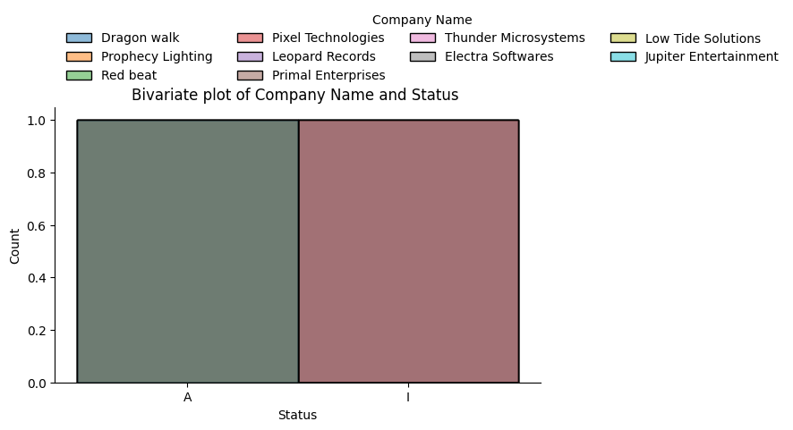
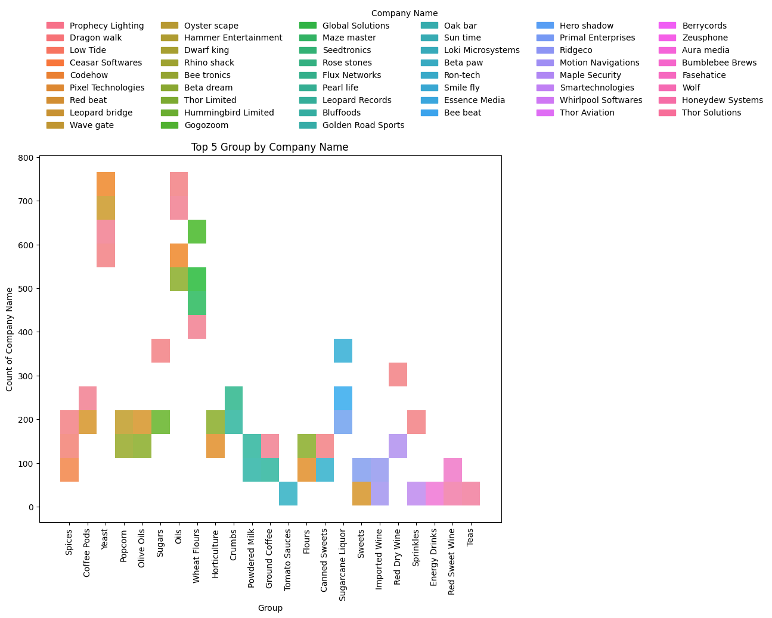
Company
Status:
The company "Red beat" appears to be dominant across multiple statuses, as indicated by its consistent presence in the top five groups for each status. This suggests that "Red beat" is strategically positioned across various business categories or sectors.
Line of Business:
"Red beat" also emerges as a significant player within the "Distributors Lv2" category, indicating its strong presence and performance in distribution-related activities. Other companies like "Leopard bridge" and "Core wares" also exhibit notable presence across different line of business categories, showcasing their diversified business operations.
City:
In terms of geographical distribution, "Red beat" holds a prominent position in cities like Roslyn, indicating its strong market presence and potential dominance in those regions. Similarly, "Leopard bridge" and "Primal Enterprises" demonstrate significant activity levels in Roslyn, suggesting strategic focus areas for these companies.
Product:
Companies like "Dragon walk" and "Prophecy Lighting" are notable for their extensive product portfolios, with a diverse range of products contributing to their overall performance. These companies exhibit high activity levels across various product categories, indicating a broad market reach and consumer engagement.
Group:
"Prophecy Lighting" and "Dragon walk" stand out as leaders in specific product groups such as Spices and Coffee Pods, respectively. This suggests a focused approach towards certain product categories, potentially leveraging their expertise or market opportunities in these segments.

Slide 24
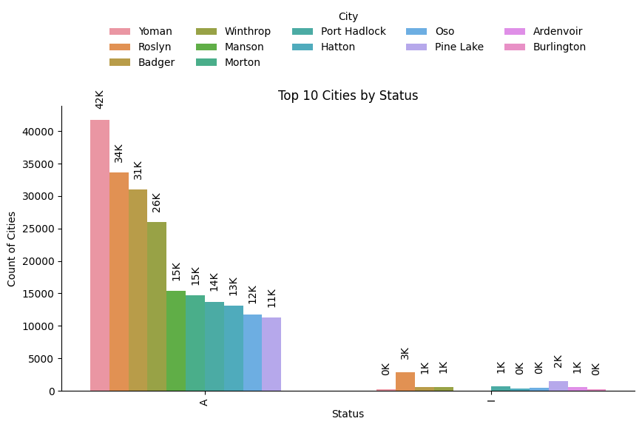
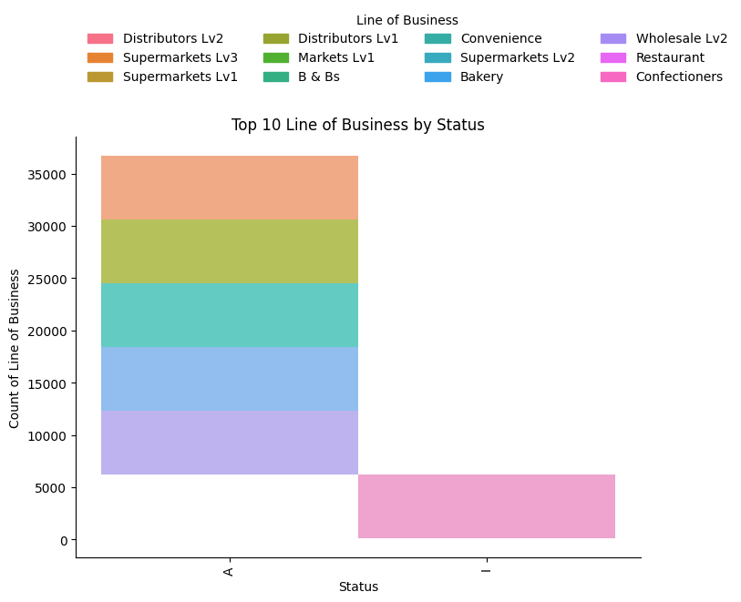
status
Top Line of Business by Status:
The top line of businesses for Status A includes "Distributors Lv2," "Supermarkets Lv3," and "Supermarkets Lv1," indicating a strong presence in distribution and supermarket operations and only confectioners belong to status I.
Top Cities by Status:
In Status A, cities like Yoman, Roslyn, and Badger have the highest counts, suggesting significant business activities or market dominance in these regions.
Top Products by Status:
Status A's top products include Product 157, Product 235, and Product 1154, indicating the popularity or sales dominance of these products within Status A.
Top Groups by Status:
The most common product groups for Status A are Yeast, Oils, and Wheat Flours, providing insight into the primary product categories associated with this status.

Slide 25
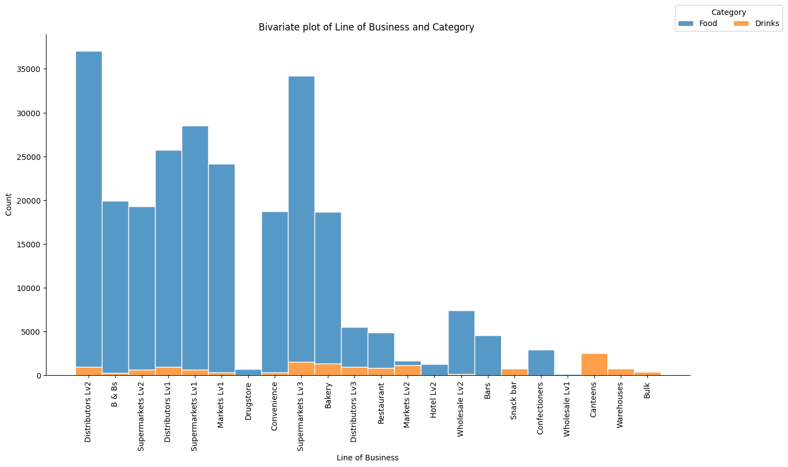
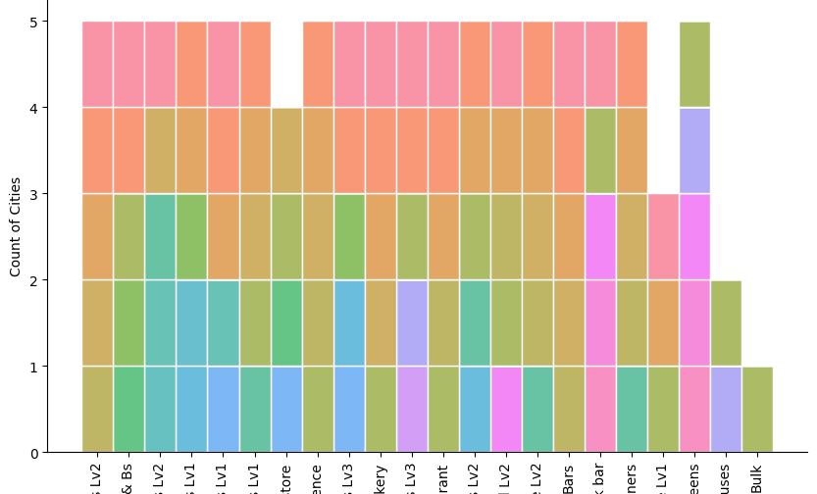
Line of Business
Product Analysis:
Distributors Lv2 predominantly sell Product 2233, Product 839, and Product 157, indicating high demand for these items.
Similarly, in the B & Bs category, Product 1839, Product 235, and Product 1842 are among the top-selling items, reflecting the preferences of consumers frequenting bed and breakfast establishments.
top-selling products allows businesses to optimize their inventory, focus on high-demand items, and tailor their product offerings to meet consumer preferences effectively.
Group Analysis:
Within distributors Lv2, yeast, oils, and wheat flours emerge as the top-selling groups, indicating a strong demand for baking and cooking essentials.
In contrast, in the B & Bs segment, horticulture, sugars, and flours are dominant, reflecting a focus on amenities and provisions catering to guests' comfort and culinary preferences.
City Analysis:
In the distributors Lv2 category, Yoman, Roslyn, and Badger emerge as the top cities with the highest transaction counts. This indicates significant distribution activity in these regions.
The dominance of specific cities suggests potential hubs for distribution centers or strong consumer demand clusters.

Slide 26
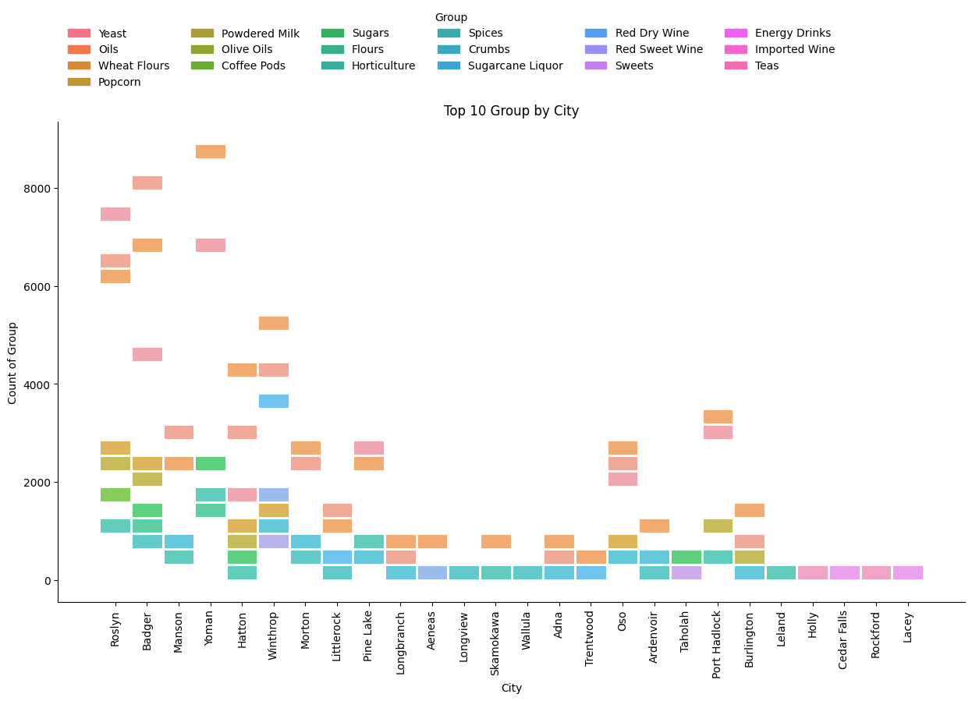
Product
Top 10 product Groups by City:
Roslyn:
Yeast: 7551
Oils: 6592i
Wheat Flours: 6142
Popcorn: 2780
Powdered Milk: 2233
Olive Oils: 1697
Coffee Pods: 1675
Sugars: 1179
Flours: 1127
Horticulture: 1053
Flours: 1127
Horticulture: 1053
it's evident that Roslyn emerges as a significant hub for product distribution, particularly in the categories of food and beverages. The top five products sold in Roslyn include Product 157, Product 1154, Product 2233, Product 235, and Product 668, with considerable quantities sold in each. Notably, Badger also demonstrates robust sales, with Product 235, Product 157, Product 1154, Product 2233, and Product 839 being the top-selling items.
Delving deeper into product categorization, Roslyn exhibits a diverse range of product groups, showcasing its versatility in catering to various consumer needs. Key product groups dominating Roslyn's market include Oils, Wheat Flours, Popcorn, and Powdered Milk. These groups illustrate the breadth of offerings available in Roslyn, appealing to a wide spectrum of consumer preferences and demands. On the other hand, least sales cities include holly, cedar, rockford.

Slide 27
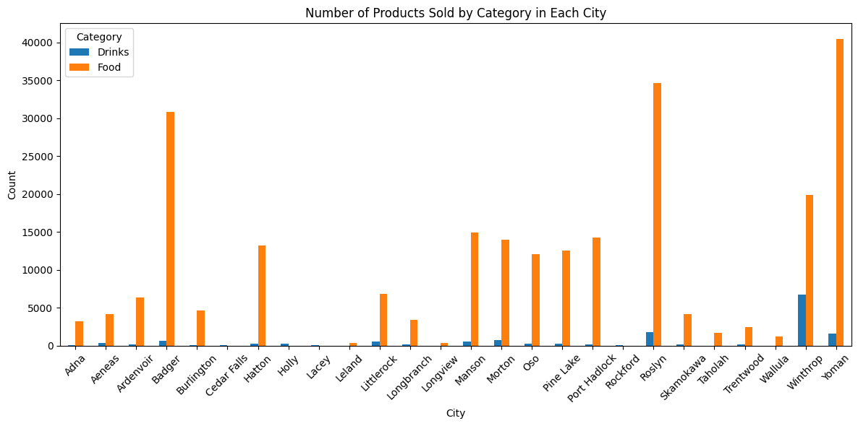
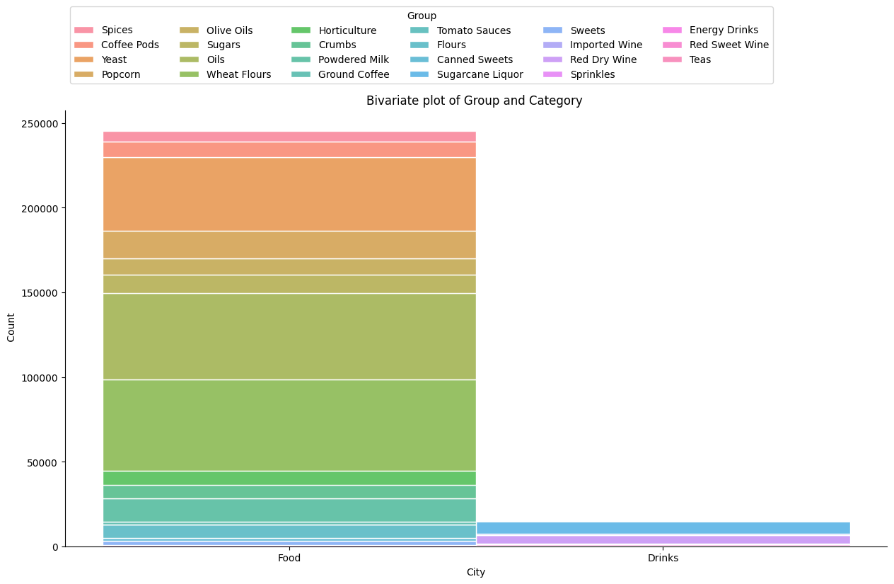
Category
Food Sales:
Yoman has the highest sales of food products.
Roslyn follows Yoman in food sales.
Badger Lacey and Port Hadlock have equal sales, which is none, in the food category.
Drink Sales:
Winthrop has the highest sales of drinks.
Oils,wheat flours and yeast are most sold items in food category
Sugarcane liqours is most selling item in drinks

Slide 28
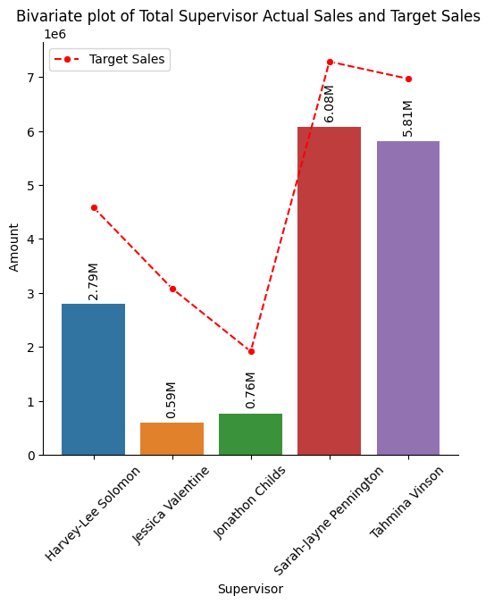
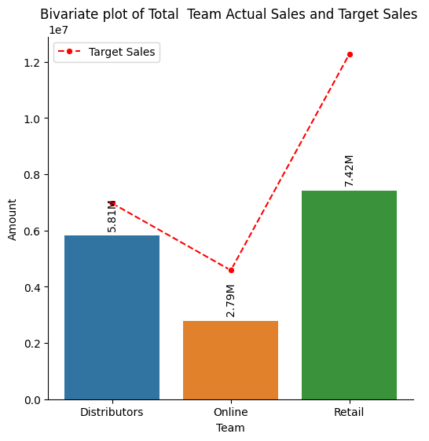
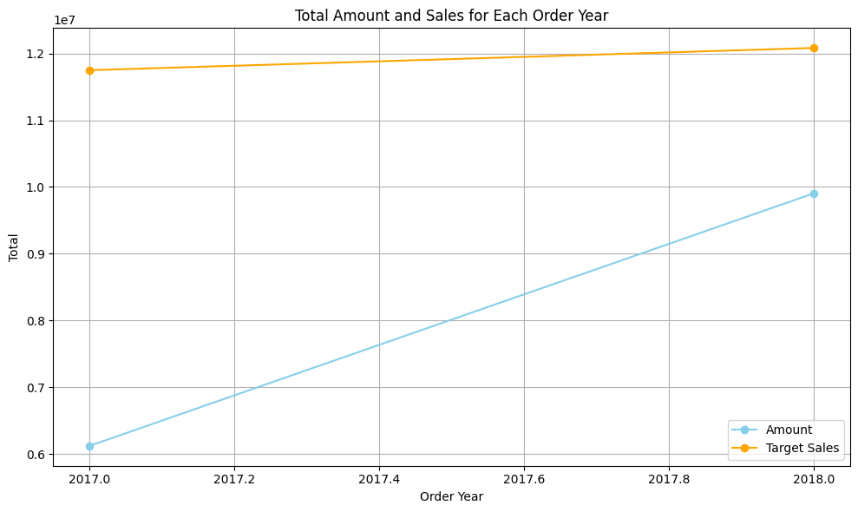
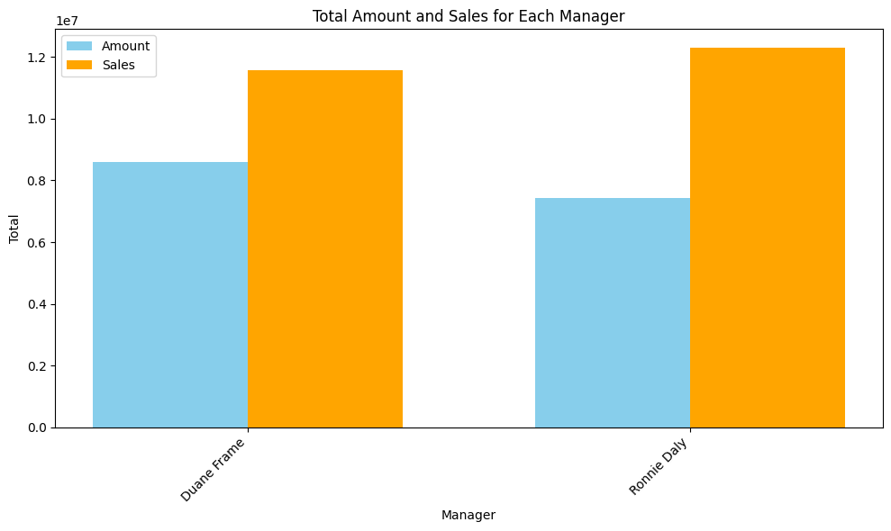
Actual Sales v/s Target Sales
The performance analysis reveals varying degrees of achievement in reaching sales targets across different managerial, salesperson, supervisor, and team categories. Manager Duane Frame stands out with an impressive 74% attainment of the target sales, showcasing effective management and strategy execution. Conversely, Manager Ronnie Daly follows closely behind, achieving 60% of the target, indicating solid performance but with room for improvement. Among salespersons, individual performance highlights the disparity in reaching targets, with Salesperson 215.265 nearly meeting the set target, while Salesperson 102 trails behind as the lowest achiever.
Supervisors Tahmina and Sarah demonstrate commendable performance, both meeting their sales targets, whereas Supervisor Jessica lags behind with the lowest attainment compared to the set target. Team-wise analysis reveals that Distributors have excelled, achieving up to 83% of their target sales, showcasing their effectiveness in distribution channels. On the other hand, Online and Retail teams have reached 60% of their respective targets, indicating opportunities for enhancement in their sales strategies and execution.
Examining the annual performance, the analysis indicates a gradual improvement in target achievement over the years. In 2017, sales targets were achieved up to 52%, reflecting initial challenges or market dynamics. However, in 2018, there was a significant enhancement, with targets being met up to 81%, showcasing adaptability, strategic adjustments, and potentially improved market conditions.

